Slide 1
TOPIC A:
DATABASES
LESSON A-4
SCHEMA, DATA DICTIONARY, & MODELLING

Slide 2
AGENDA
Warm-up Question
Schema
Conceptual Schema
Entities
Attributes
Relationships
Logical Schema
Keys
Physical Schema
Data Definition Language
Data Modelling
NOTE!
Have a way to take notes available for this lesson

Slide 3

THE WARM UP QUESTION
What are some security measures that a database may have to protect data?
Think in terms of security from failure and intrusion

Slide 4
THE WARM UP ANSWER
Prevents unauthorized access
Encryption
Enforces data integrity and consistency
Activity Tracking
Ensures atomic transactions

Slide 5
SCHEMA
Database Schema refers to the architecture that shows how data is organized and how the relationships between data is managed.
Database schema provides a logical view of the database
There are three different kinds of schema
Conceptual Schema
Logical Schema
Physical Schema

Slide 6
CONCEPTUAL SCHEMA
Conceptual Schema is an abstract model describing the structure of the data, but without talking about technical physical implementation details
It’s a high level representation of the database
Which means it’s more abstracted from the database itself
Conceptual Schema defines the Entities, Attributes, and Relationships that make up a database

Slide 7
ENTITIES
Entities are the objects or items in our database
Entities are represented by a full table in our DBMS, such as in access
Entities do not have to mimic an actual object in the real world, but can also mimic concepts such as an order
Product
Orders
Customers

Slide 8
ATTRIBUTES
Attributes are the properties of specific entities
Each entity can have multiple attributes
Each attribute is a specific data type and can only hold one value
Product(ProductID, ProductName, Price)
Order(OrderID, OrderDate)
Customer(CustomerID, CustomerName, Email)

Slide 9

RELATIONSHIPS
Relationships define how entities and attributes interact with each other
Customer places an Order
Order includes one or more Products

Slide 10
LOGICAL SCHEMA
Logical Schema defines the structure of the database in more technical terms
Logical Schema still does not take into consideration the specific DBMS you may be using
You derive the logical schema from the conceptual schema by specifying data types for each attribute
Establishing relationships between tables using primary and foreign keys
Ensuring data integrity

Slide 11
KEYS
Primary Keys uniquely identify a field of a table
This usually takes the role of some sort of ID field
Records cannot share a primary key with any other record of the same entity
Foreign Keys are another table’s primary key that helps to form relationships between tables
Let’s look at an example

Slide 12
LOGICAL SCHEMA
Products
ProductID INTEGER (PRIMARY KEY)
ProductName VARCHAR (this is a string)
Price REAL (this is a real number)
Orders
OrderID INTEGER (PRIMARY KEY)
OrderDate DATE
CustomerID INTEGER (FOREIGN KEY)
ProductID INTEGER (FOREIGN KEY)

Slide 13
LOGICAL SCHEMA
Customers
CustomerID: INTEGER (PRIMARY KEY)
CustomerName VARCHAR
EmailAddress VARCHAR, UNIQUE (ensures no two people can have the same email address)

Slide 14
LOGICAL SCHEMA
Customers
CustomerID: INTEGER (PRIMARY KEY)
CustomerName VARCHAR
EmailAddress VARCHAR, UNIQUE (ensures no two people can have the same email address)
Relationships
A customer places one or more orders (one-to-many)
An order holds one or more products (one-to-many)

Slide 15
PHYSICAL SCHEMA
Physical Schema includes specifics of storage devices, access methods, indexing, and a lot of other technical details
It is written in the specific syntax for a specific DBMS
For example, the physical schema for Products may look like this
Products
ProductID: INT PRIMARY KEY AUTO_INCREMENT
ProductName: VARCHAR(100) NOT NULL
Price: REAL NOT NULL

Slide 16
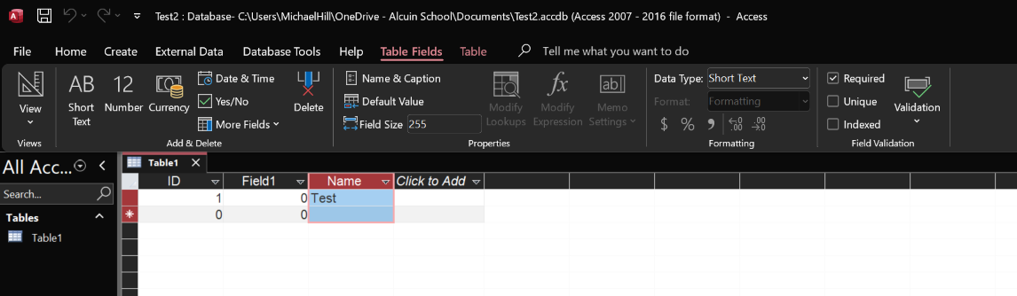
NOT NULL
To make something NOT NULL in Access, we use the “Required” checkbox when clicking on the attribute

Slide 17
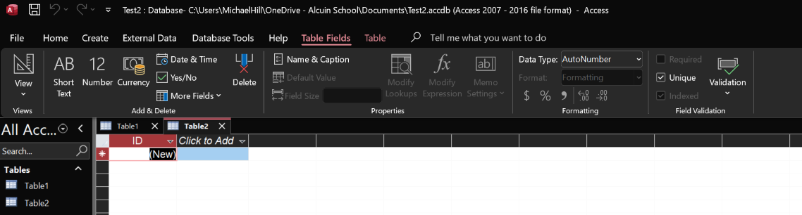
AUTO INCREMENT
When you create a new table in Access, it automatically has an ID field that will automatically go up by 1 with each new item you add
Do not mess with the data type of this field, you cannot change it back for some reason

Slide 18
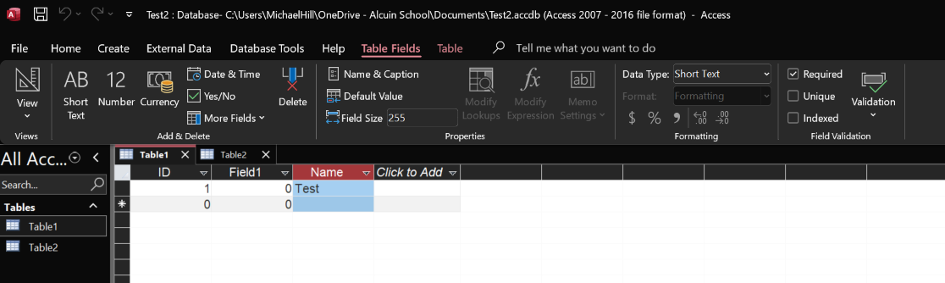
VARCHAR
VARCHAR is short for variable characters, and it provides the maximum length in parenthesis
This can be done in access using a Short Text data type, and editing the field size

Slide 19
UNIQUE
Unique is used as the property when an attribute isn’t the primary key, but still should not allow two records to have the same value

Slide 20
DATA DICTIONARY
The Data Dictionary overlaps quite a bit with the Schemas
A data dictionary is a document containing documentation about:
Tables and their fields (entities and their attributes)
Data types
Integrity constraints
Naming conventions
Locations of files
The dictionary is contextual information about the schema as it is implemented

Slide 21
DATA DEFINITION LANGUAGE
To create the database based on our schema and data dictionary, we use what’s called a Data Definition Language
Data Definition Language is what we use to write the commands that will create our database
It has its own specific syntax to do these things

Slide 22
DATA DEFINITION LANGUAGE
To create a table out of an entity, you may write something like this
CREATE TABLE Customer
(
CustomerID INT PRIMARY KEY AUTO_INCREMENT,
LastName VARCHAR(100) NOT NULL,
FirstName VARCHAR(100) NOT NULL,
ProductID INT FOREIGN KEY NOT NULL,
)

Slide 23
DATA DEFINITION LANGUAGE
Most different providers have a different way of doing this
Some don’t require this at all, and let you create the database using dropdown fields, like Microsoft Access
The specific syntax of the language is NOT uniform, and each service has a slightly different way of handling it
Fun, I know

Slide 24
DATA DEFINITION LANGUAGE
The Data Definition Language is vital to ensuring that the database is set up correctly, regardless of how different they may be
This is what enforces many of our DBMS features we talked about such as formatting and ensuring each field has a value
On the back end, even the visual stuff in Access gets converted to a DDL

Slide 25
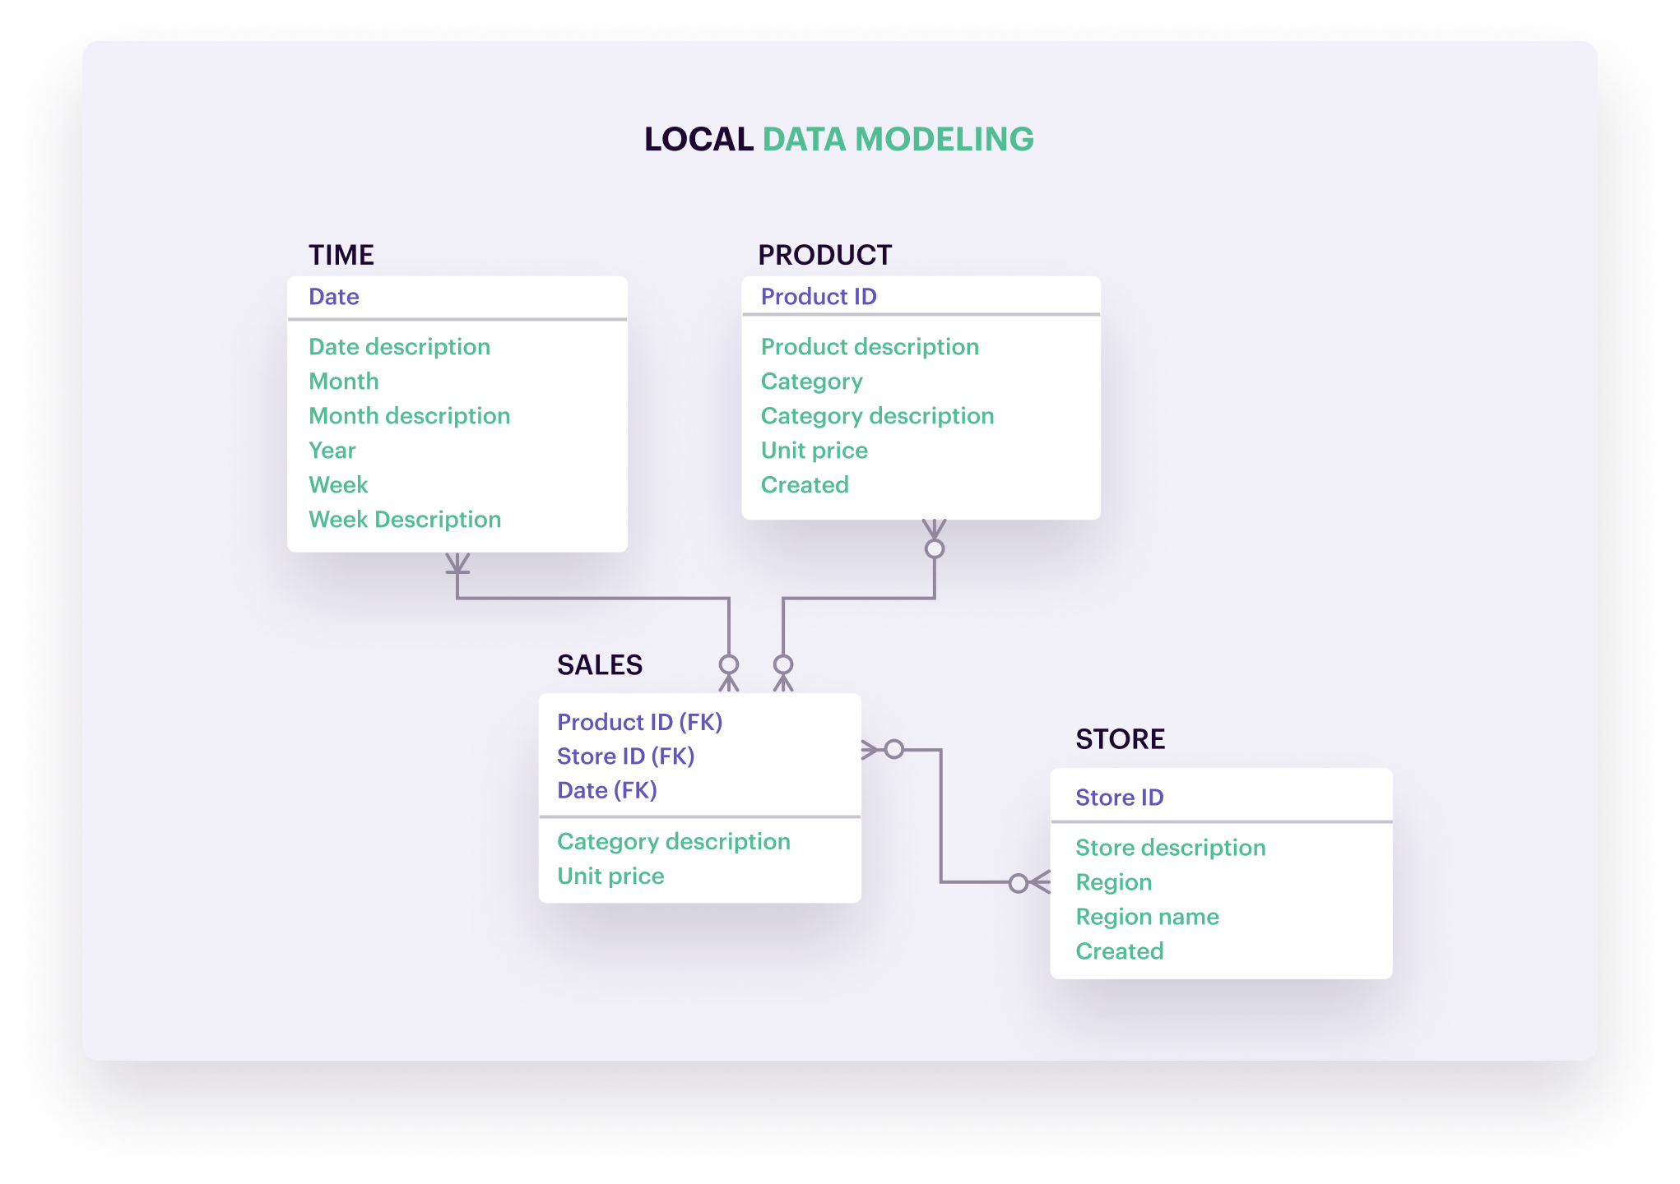
DATA MODELING
Data modeling is the creation of a visual model to represent a database
This is often done with an Entity Relationship Diagram (we’ll talk more about these later)
Doing this helps us to understand the structure of a database by looking at it from another perspective

Slide 26
PROGRAMMING ASSIGNMENT
Programming Assignment for this lesson is PA A-2.
Have fun ☺

Slide 27

VOCAB TO REMEMBER
Schema
Conceptual Schema
Logical Schema
Physical Schema
Data Definition Language
Data Modeling

